Slide 1





ATE Webinar
Addressing STEM Workforce Needs in a Virtual World –
How ATE Grants Can Help
and Why You Should Apply
1:00 – 2:30 p.m. EDT
Wednesday, June 17, 2020

Slide 2
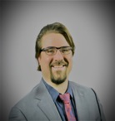
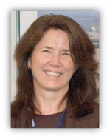
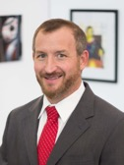
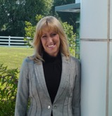
Welcome & Introductions
Jonathan Beck, Executive Director and PI
National Center for Autonomous Technologies
Northland Community and Technical College, MN
V. Celeste Carter, Lead ATE Program Director
National Science Foundation, VA
Kevin Cooper, PI, RCNET, Dean of Advanced Technology
Indian River State College, FL
Michele Norgren, Director and PI
VESTA National Center, MO

Slide 3
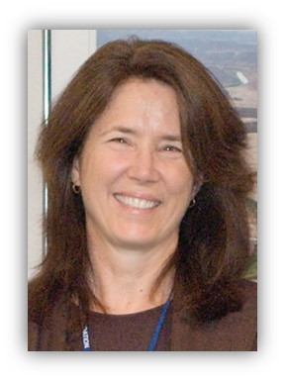
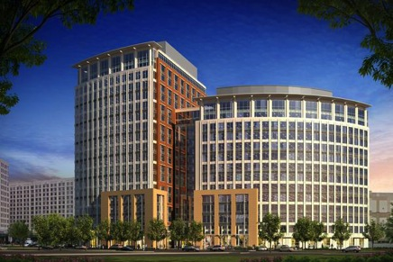
Welcome from NSF
Dr. Celeste Carter, NSF Program Director
ATE Lead Program Officer
National Science Foundation

Slide 4

Agenda
I: Introduction to the NSF ATE Program
∙ NSF – the agency
∙ Opportunities for NSF ATE Grant Funding
II: Virtual Teaching & Learning Strategies through ATE
∙ National Center for Autonomous Technologies
∙ VESTA National Center
∙ RC-NET
III: ATE Proposal Resources
∙ Tips for Success

Slide 5
Poll
What is your current role at your institution?
Faculty
Administrator
Grant Writer
None of the Above

Slide 6
National Science Foundation
Division of
Graduate Education (DGE)
Research on Learning in Formal and Informal Settings (DRL)
Human Resource Development (HRD)
Undergraduate Education (DUE)
EHR

Slide 7
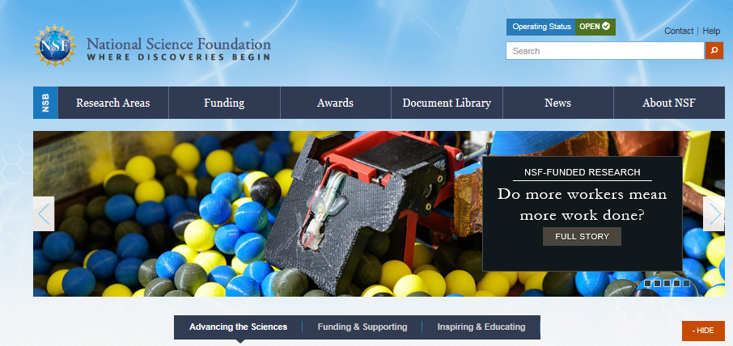
www.nsf.gov
Finding ATE
ATE or 18-571
ATE

Slide 8
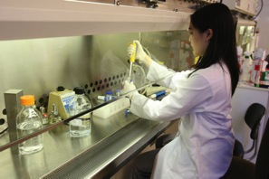

Advanced Technological Education (ATE)
The education of highly qualified science and engineering technicians for advanced-technology fields that drive the nation’s economy.
  Community and Technical Colleges (2-yr IHES) have leadership roles on all projects.
  Grades 7-12, 2yr- and 4-yr institutions can be supported. (Pathways)
  Partnerships with Industry and Economic Development Entities – Hiring Needs

Slide 9
ATE Program continued
Four Program Tracks
ATE Projects
Small Grants
For Institutions
New to ATE
Up to $300K, 3-yr.
Targeted Research in Technician Education
Up to $600k, up to 3 yrs
except
Adapt & Implement
$300-400K
Instrumentation
Acquisition
$400-500K
ATE Centers
From $150k, up to 2 yrs to $800k, up to 3 yrs
Two Types
Center
Resource Centers
Up to $7.5M
5 yrs
Up to $1.65M
3 yrs
Deadline (All Tracks):
October 1, 2020

Slide 10
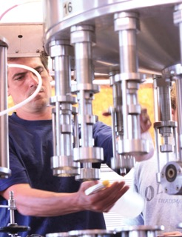
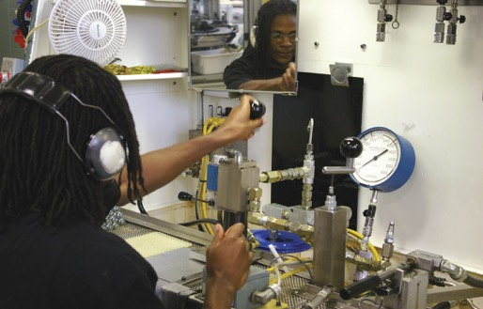

ATE Projects
Projects - up to $200,000 /yr. ($600,000 max.), 3yrs.
  Program Development, Implementation and Improvement;
  Professional Development for Educators;
  Curriculum and Educational Materials Development;
  Teacher Preparation;
  Small Grants for Institutions New to the ATE Program ($300K, 3-yrs.);
  Adaptation and Implementation (A&I); $300-400K, 2-3 yrs.);
  Instrumentation with Curriculum Updates; $400-500K, 2-3 yrs.)
  ATE-Coordination Networks (up to $600,000, 3 yr.)

Slide 11
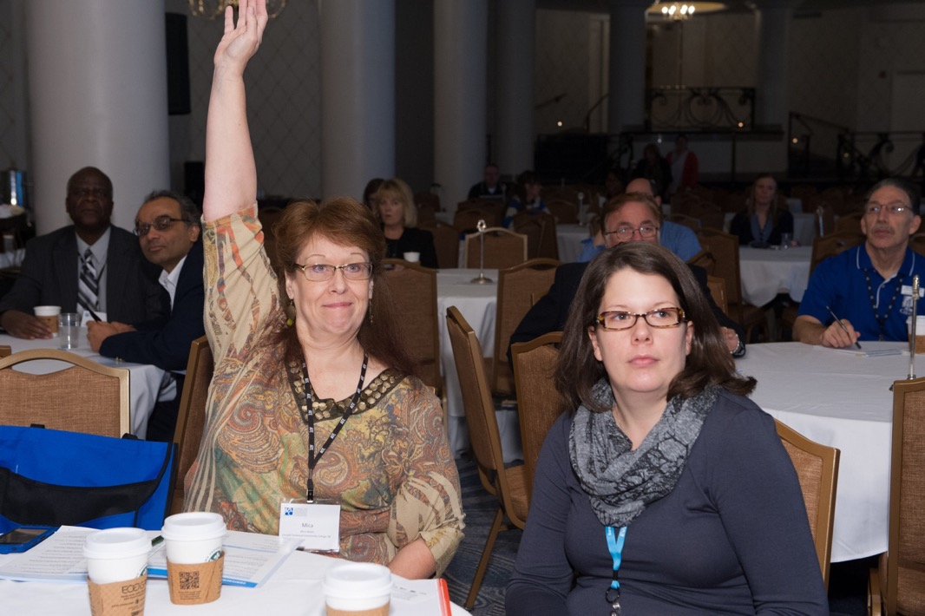
Questions

Slide 12
National Center for Autonomous Technologies (NCAT)
Jonathan Beck
Principal Investigator & Director | National Center for Autonomous Technologies (NCAT)

Slide 13
Innovation Born in Surreal Times
State of Education
  Challenging
  State of Evolution
  Constantly Adapting
  Implementing New Strategies
  Integrating New Technologies
  Then a Pandemic Hits Requiring Social Distancing Over Night
ATE Community
  Innovators and Change Agents
  Constantly Seeking New Opportunities
  Thinking Outside the Box
  Promoting Collaboration
  Existing Resources to HELP

Slide 14
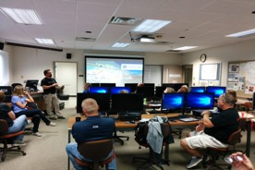
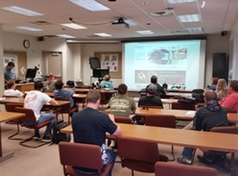
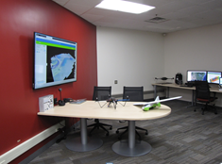
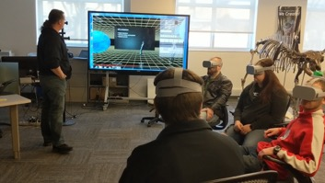
NCAT - So Now What?
NCAT Response
  Plan for Everything or Pivot?
  Unique Flexibility, Workshops, Camps and Competitions
  Partners and Networks

Slide 15
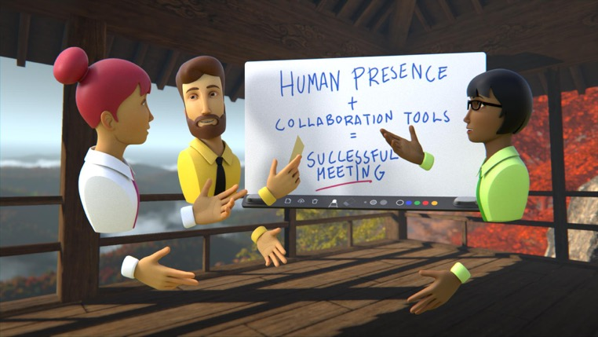
What Options are Available ?
Webinar Series
  Overview of Distance Delivery Modalities
  VR for Social Engagement
  Digital Content Development
  Video Production
  Content Packaging

Slide 16
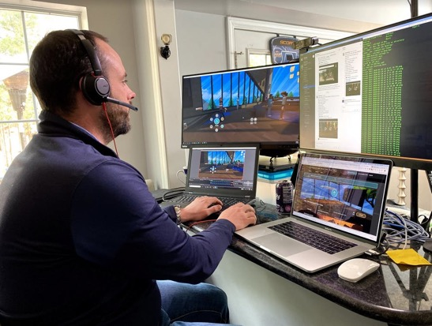
Considerations and Planning
Equipment Supply
  In Demand
Access to Technology
  Video Capture Kits
Platforms for Delivery
  Level of complexity

Slide 17
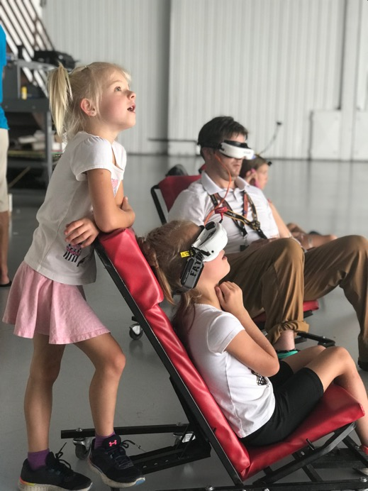
Ancillary Benefits
Engaging Students
  Inspiring Curiosity
  New Perspectives Increase Active Learning
Student Recruitment
  No Lab Tours but Here is What you Can Expect
Reshaping Learning
  Increase Collaboration and Simplify the Concepts
Increased Exposure to Future Work Force Technology
  The Future of Work is Changing, We Should Too

Slide 18
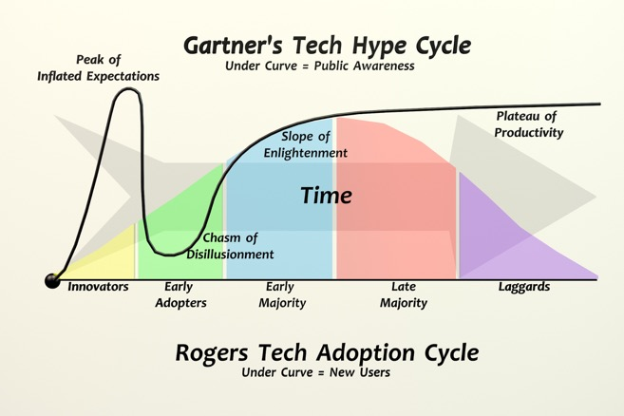
Thinking Long Term
Enhanced Resources
Improved Quality in Education
Equity and Inclusion
Additional Delivery Options
Evaluation and Continuous Improvement

Slide 19
NSF ATE MINDSET
Technology Complicates
Technology Advances and Creates Opportunities
Technology Limits Access
Technology Enables New Ways to Learn
Technology that Seems Strange Shouldn’t be Explored
Technology Innovation is about Trying New Things

Slide 20


Questions?
This material is based upon work supported by the National Science Foundation under Grant No. DUE 1902574. Any opinions, findings, and conclusions or recommendations expressed in this material are those of the author(s) and do not necessarily reflect the views of the National Science Foundation.

Slide 21



Michele Norgren
Director and PI
VESTA National Center, MO

Slide 22



http://wineamerica.org/impact

Slide 23
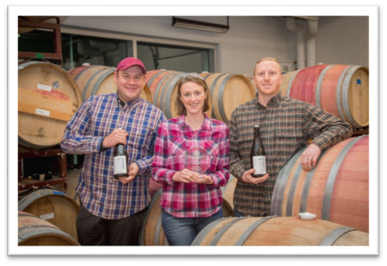
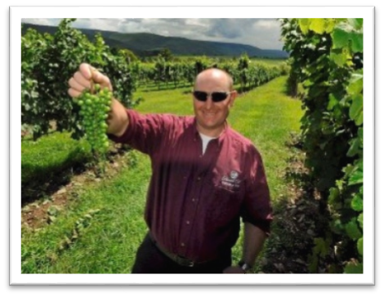

Viticulture & Enology
Science & Technology Alliance
Industry-Guided Design to Address the Workforce Needs of the U.S. Grape and Wine Industry
Recognizes the Accessibility Challenges for Students Who are Generally Rurally Located and Travel-limited
First For-Credit Distance Education Program in Viticulture, Enology and Wine Business Entrepreneurship
Industry-Validated Program of Online Courses, Structured Field Experiences and Workshops Leading to Technical Certificates and AAS Degrees.

Slide 24


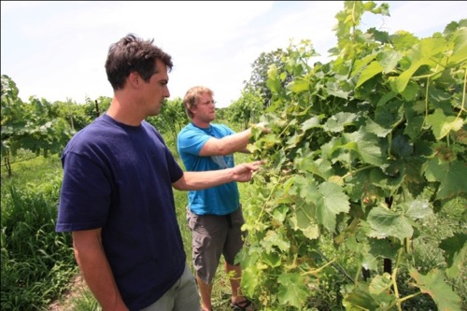
Rigorous and Comprehensive Educational Program
39 online courses
3 educational tracks – viticulture, enology, and wine business entrepreneurship.
Multiple educational paths
  Individual courses
  Technical Certificate
  Associate of Applied Science
Curriculum that is industry driven and supervised by notable professors
  Dr. Anne Fennell, South Dakota State University
  Dr. Barry Gump, Florida International University
Dedicated Instructional Designer
  Dr. Nicholas Farha, Missouri State University

Slide 25

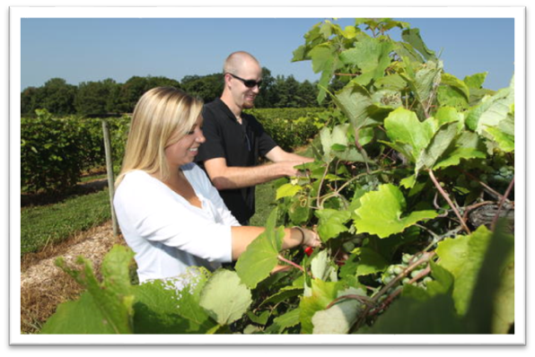
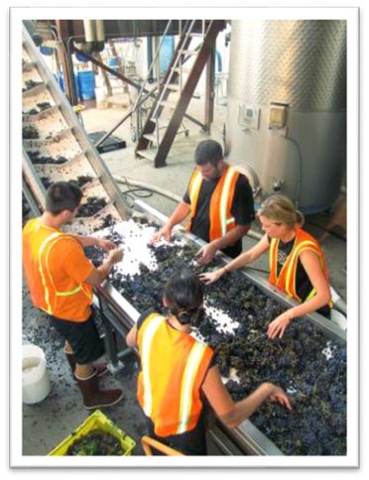
Infusing VESTA Courses with
Workplace Hands-on Learning
Field Practicums
  Mentored Field Experiences Integrated into Viticulture and Enology
  Apply Knowledge and Develop Critical Skills
  Durations Aligned with Course Learning Objectives
Workshops
Virtual Vineyards and Wineries
  Computer Simulations & Virtual Reality Models
  Enable Real-World Problem Solving

Slide 26
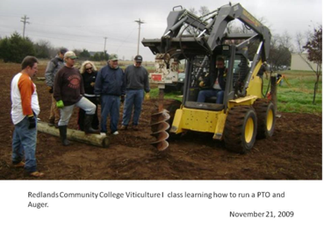
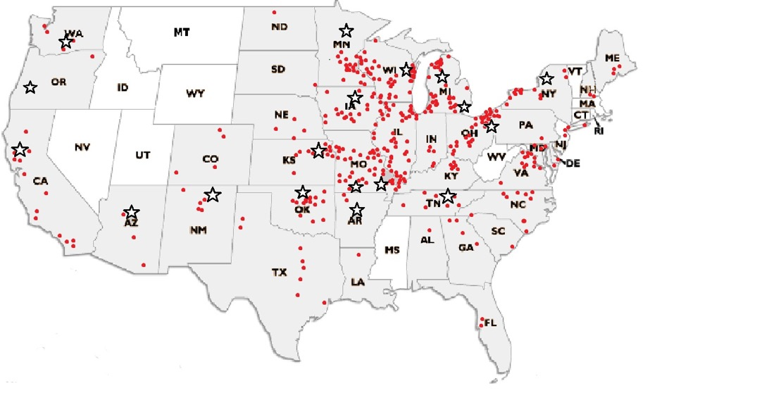
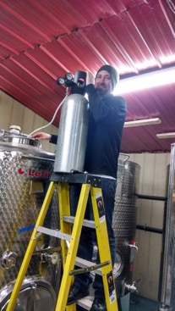
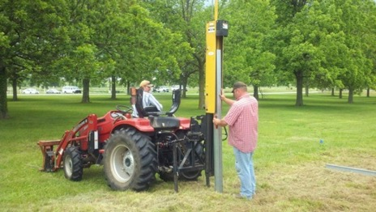
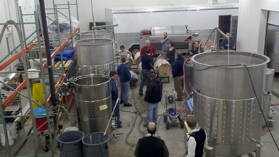
Onsite Field Practicums
Onsite field practicums
  (over 600 industry partners in 41 states and 6 foreign countries.)
Opportunity to work alongside industry mentors.

Slide 27


Innovative use of distance educational technologies
Synchronous and Asynchronous distance educational technologies.
Mobile compliant for the student on the go.

Slide 28
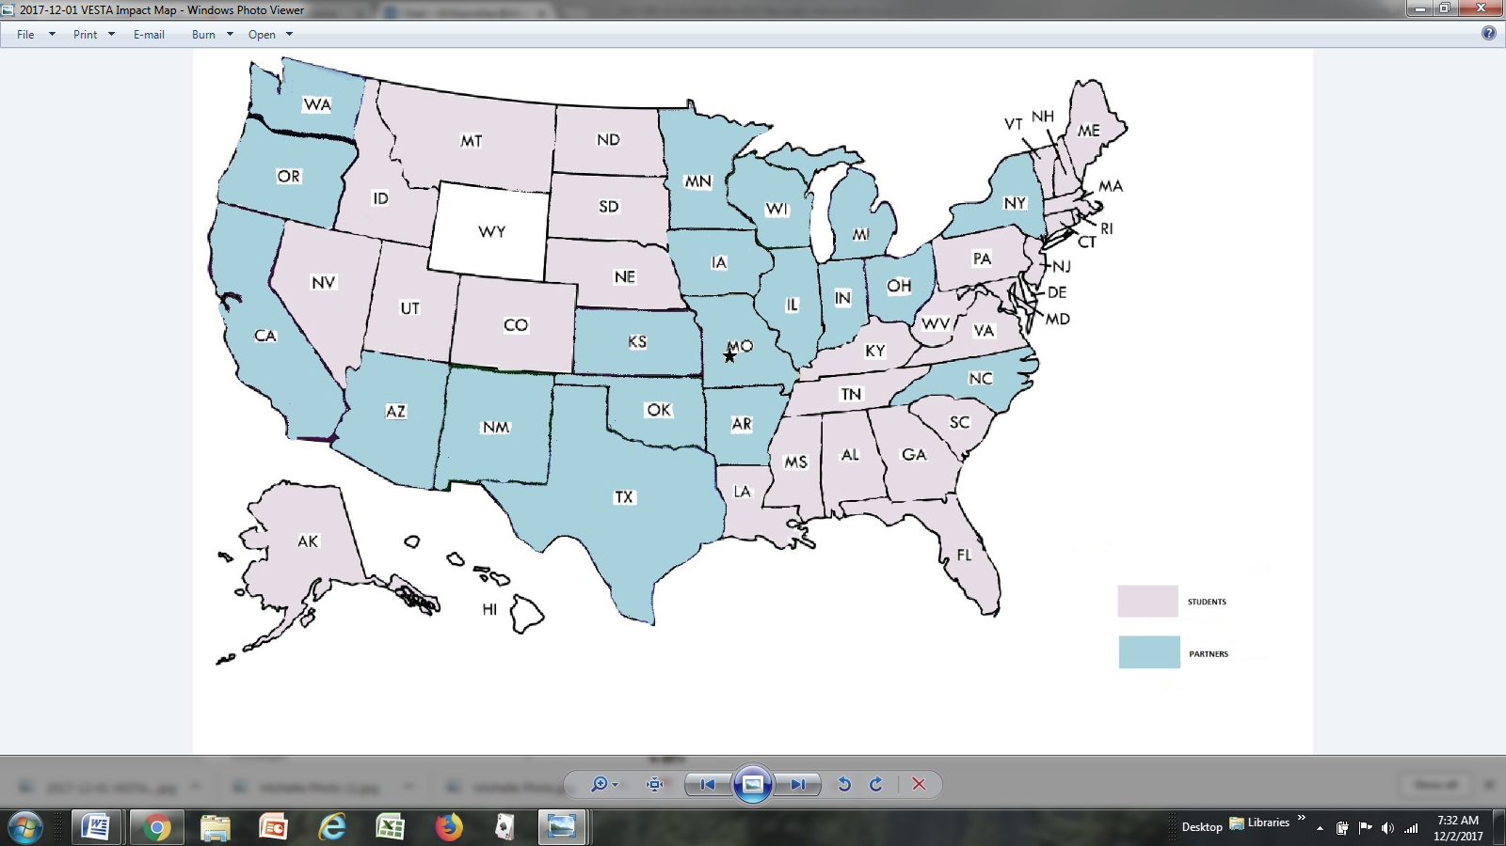

VESTA – has a National Foot Print for Viticulture and Enology Education
Partnership of 2- and 4-year Colleges and Universities in 19 States Across the U.S.
600+ Mentor Wineries and Vineyards across the U.S. and 6 Foreign Countries
Students
Enrollment of over 6,000 Since 2003
Students from 48 States, DC, and 12 Foreign Countries
Students & Partners

Slide 29
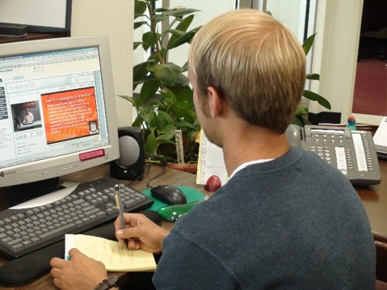




Thank You
Questions??

Slide 30



Reintegration Post-COVID
Kevin Cooper, PI RCNET & Dean Advanced Technology @ IRSC

Slide 31


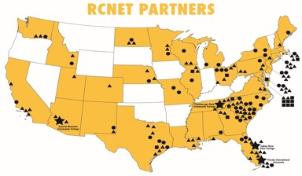
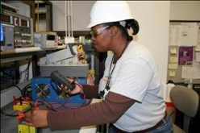
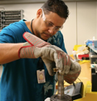
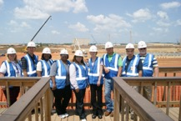
Regional Center for Nuclear Education & Training
Regional Center for Nuclear Education & Training
MISSION: RCNET is an NSF ATE CENTER. Established in 2011, RCNET’s mission is to make sure the demand for skilled nuclear technicians is met in a standardized and systematic way.
PARTNERSHIPS: RCNET is headquartered at Indian River State College in Fort Pierce, FL and is a consortium of of 100 industry, 55 academic, and 15 agency partnerships across the United States and 7 countries
OUTCOMES: RCNET has become a viable workforce pipeline, largely due to an ever-expanding network. RCNET’s largest measure of success is the placement of over 3,000 program graduates in nuclear technician jobs at over 60 industry partner locations.

Slide 32
Common Program Details – Pre COVID-19
Enrollment was ~ 24 - 48 FT students per school
80% in-person
~ 50% Hands on & 50% Lecture
Embedded Industry Certifications
Summer Internships
Direct Outreach & Recruiting

Slide 33
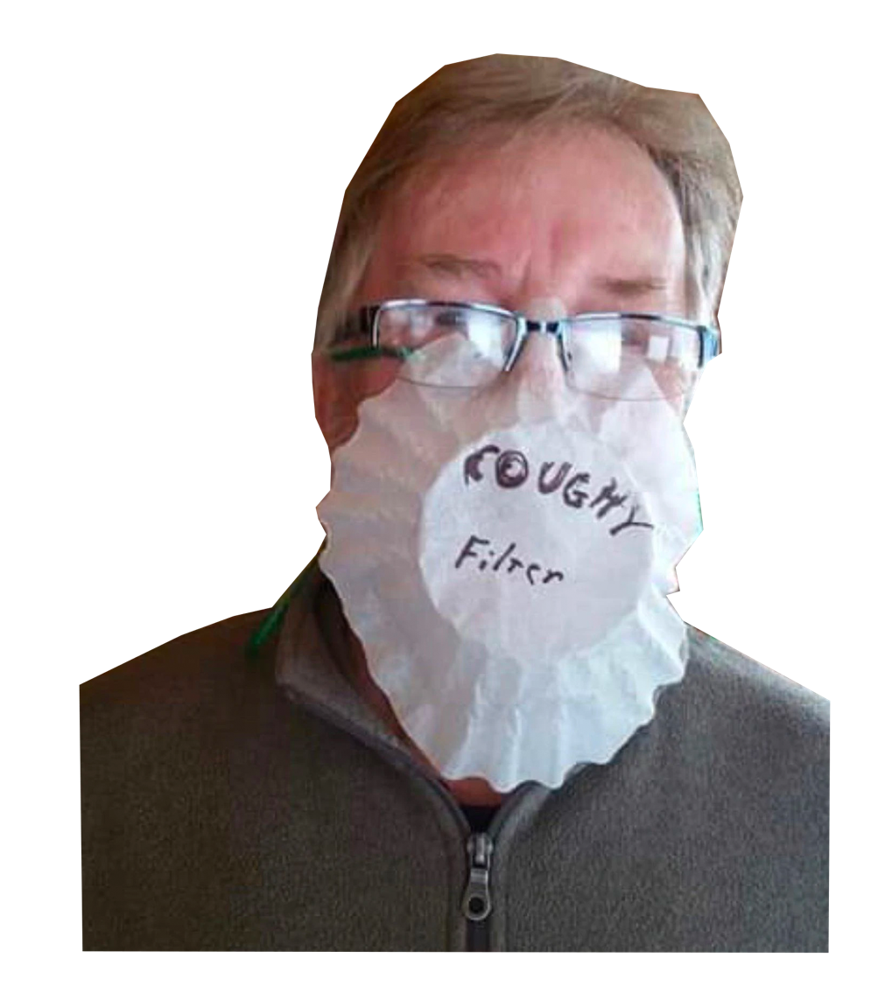

Slide 34
Resources Thanks to ATE & the ATE Culture
Network
Tons of Online Resources
Dynamic Personnel
Dynamic Budgets

Slide 35
RCNET & IRSC’s Support
Curriculum
Continuity of Operations
Marketing & Outreach

Slide 36
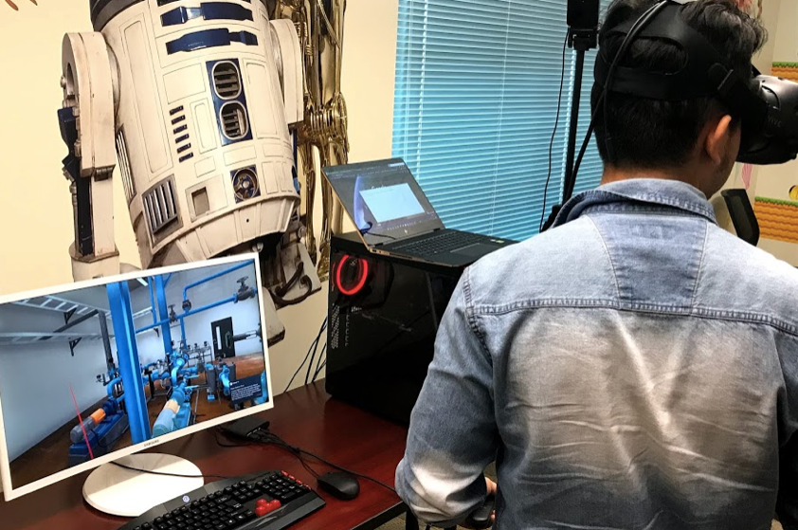
Online Curriculum Solutions & Support
18 Courses segmented into course leaning outcomes modules (or cartridges)
Full Environmental Management A.S. Degree
Built to Quality Matter Specifications for Blackboard.
VR resources with hands on activities matching key industry training events
  Tagging and Start Up Procedure
  Maintenance Procedure
  Event Response

Slide 37
Continuity of Operations
Scheduling Advice
Operating Procedures
The overall class is ~ 20 students broken into two 10 person blocks for staggered live training
~70% of fundamental material online done as a whole class of 20 students
~ 30% in person which equates to 1 live lab, lecture, group project every 2 weeks. This portion is staggered into two groups of ten and repeated by the faculty twice ~ once every 2 weeks.
The faculty receives 4 credits instead of 3 because they are doing ~ 30% more work (i.e. repeating the 30% two times)

Slide 38
Marketing & Outreach
Academia went Online (K-12)
Academia had trouble filling a daily agenda

Slide 39

  Thank You & Questions
      Kevin Cooper
      kcooper@irsc.edu
      772-634-8095

Slide 40
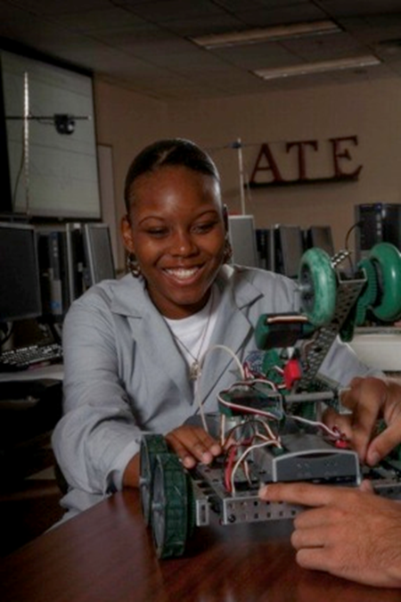
Advice from Program Officers
Read the solicitation!
Choose right program track
Start early
Faculty-driven concept & work plan
Get help – avoid errors
  Program Officers
  Project/Center PIs
  Proposals submitted need to be in compliance with both the ATE solicitation and the NSF Proposal & Award Policies & Procedures Guide (PAPPG) (NSF 20-1)
  https://www.nsf.gov/pubs/policydocs/pappg20_1/index.jsp
  Be alert to guidelines

Slide 41
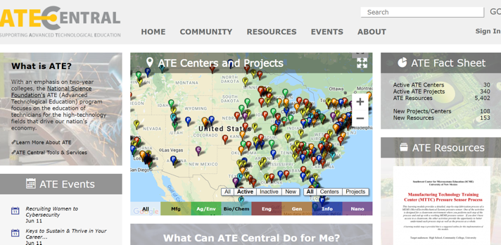
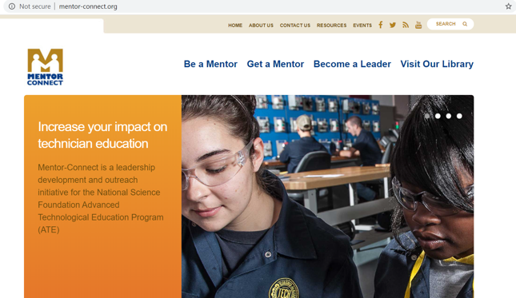
ATE Resources
www.atecentral.net
www.mentor-connect.org
www.Evalu-ate.org
www.nsf.gov/ate

Slide 42
Thank You & Contact Info
AACC
ate@aacc.nche.edu
202-416-4510

